Slide 1

Topic: Fractions
EQ: How do we compare fractions?

Slide 2









24
7
30
Topic: Fractions
Date
EQ: How do we compare fractions?
Let’s do a Quickwrite!
In the LHS of your book you have 1 minute to write down everything you know about “Fractions”.
Be prepared to share with the class.
Using whiteboards or paper have students to sketch a rectangle, with shading, to show these fractions:
$$\frac{1}{4}$$
$$\frac{1}{2}$$
$$\frac{2}{4}$$
$$\frac{3}{4}$$
$$\frac{1}{3}$$
$$\frac{2}{3}$$
$$\frac{3}{3}$$
$$1\frac{1}{4}$$
$$\frac{5}{4}$$
Notes:
Doing improper and mixed fractions in next line – on slide just to see if they have any knowledge of them

Slide 3
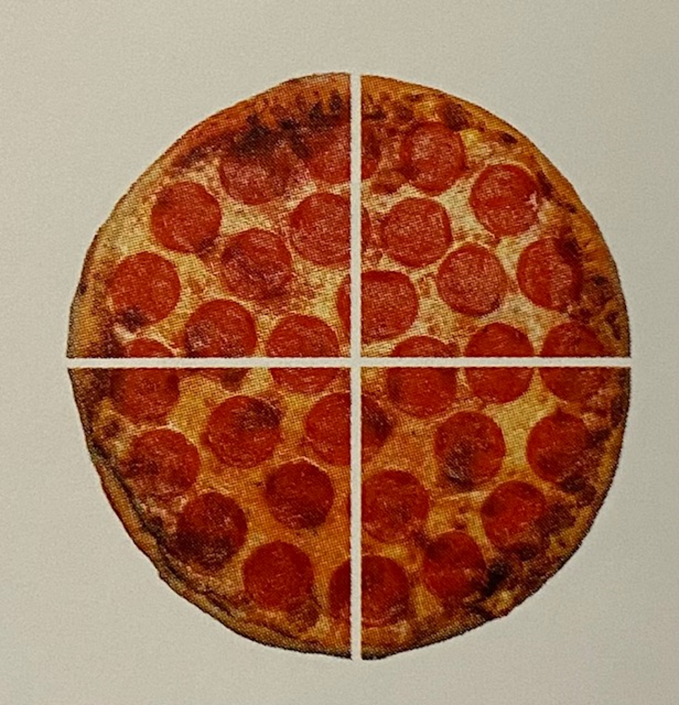


24
7
30
Topic: Fractions
Date
EQ: How do we compare fractions?
What is a fraction?
A fraction is a part or portion of a whole
$$\frac{4}{9}$$
numerator – number of equal parts out of whole
Denominator – total number of parts in the whole
How do we write fractions?
Line in the middle is the vinculum
We have a pizza cut into 4 equal pieces, the denominator is 4.
If you eat one piece out the whole, the numerator is 1 and you have eaten $\frac{1}{4}$ of the pizza.

Slide 4
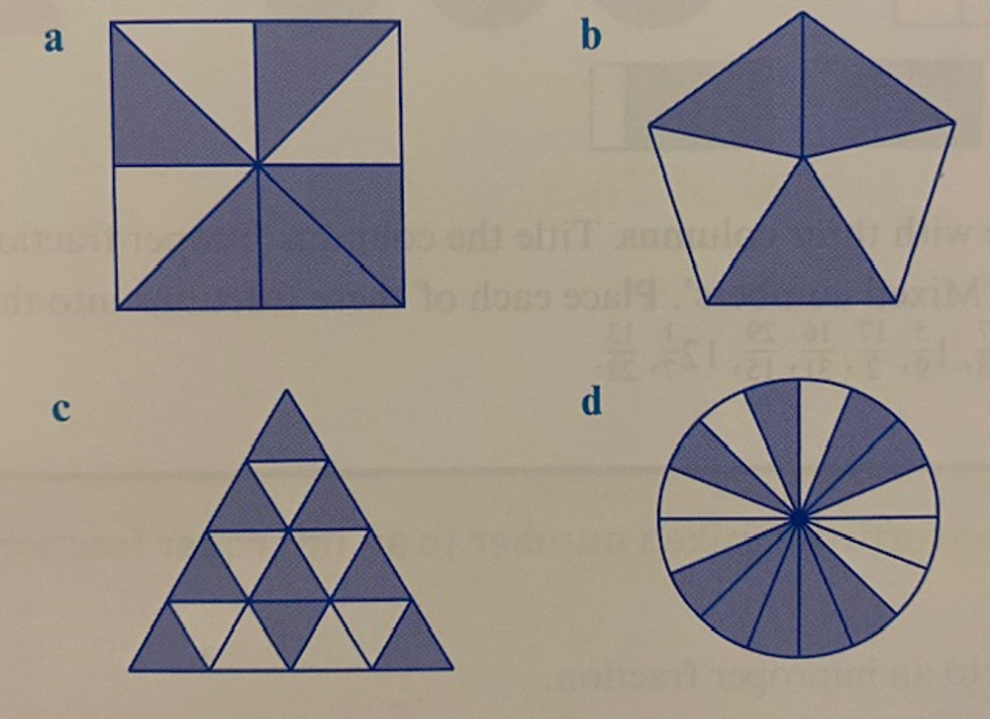
24
7
30
Topic: Fractions
Date
EQ: How do we compare fractions?
What fraction of the shape is shaded?

Slide 5

24
7
30
Topic: Fractions
Date
EQ: How do we compare fractions?
Would the value of this be greater than or less than 1?
What type of fraction is this?
$$\frac{4}{9}$$
It is less than 1!
When the value is less than 1, it is called a proper fraction.
The numerator is smaller than the denominator
Have students place 1/5, 2/5, 3/5, 4/5 on the number line
0
2
Notes:
Do number line with numbers with same denominator
Depending on students can try different ones

Slide 6


24
7
30
Topic: Fractions
Date
EQ: How do we compare fractions?
How do we compare the size of fractions?
$$\frac{4 }{9}$$
$$\frac{6 }{9}$$
With your shoulder partner discuss:
Which fraction is bigger and why?
When the denominator is the same, then the fraction with the largest numerator is the biggest

Slide 7

24
7
30
Topic: Fractions
Date
EQ: How do we compare fractions?
How do we compare the size of fractions?
$$\frac{6 }{11}$$
$$\frac{6 }{9}$$
With your shoulder partner discuss:
Which fraction is bigger and why?
When the numerator is the same, then the fraction with the smallest denominator is the biggest

Slide 8

24
7
30
Topic: Fractions
Date
EQ: How do we compare fractions?
How do we compare the size of fractions?
$$\frac{6 }{11}$$
$$\frac{4 }{9}$$
With your shoulder partner discuss:
Which fraction is bigger and why?
We can compare each fraction to a half to find the biggest

Slide 9


Slide 10
24
7
30
Topic: Fractions
Date
EQ: How do we compare fractions?
Complete the Comparing Fractions worksheet
Write your summary for the lesson in your book.
Share with your table one new thing that you learnt today.

